Slide 1
Terminal friendly Debugging in Ruby
Based on "Debugging in Ruby (IDE => puts => ...?)"
presented 05 June 2019@CSRug Ruby Meetup (first Wednesday in the month)
=)K

Slide 2

Courtesy of the Naval Surface Warfare Center, Dahlgren, VA., 1988. (https://commons.wikimedia.org/wiki/File:H96566k.jpg), „H96566k“, marked as public domain, more details on Wikimedia Commons: https://commons.wikimedia.org/wiki/Template:PD-US
Notes:
“Debugging is the process of finding and resolving defects or problems within a computer program that prevent correct operation of computer software or a system.” (https://en.wikipedia.org/wiki/Debugging)
… or removing physical bugs from physical computers ;o)
Admiral Grace Hopper (Grace Brewster Murray Hopper, “Grandma COBOL”, lead FLOW-MATIC development)
https://en.wikipedia.org/wiki/Grace_Hopper

Slide 3
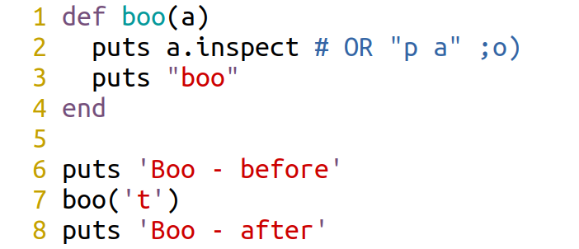
Puts
Notes:
if you forget to print something, you will have to re-run

Slide 4
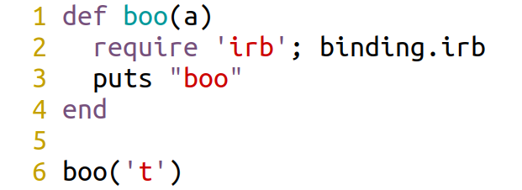
IRB (PRY)
ruby 2.4.0, 2016-12-25
Notes:
but If you forget & commit, bad things will happen ;o)
https://www.ruby-lang.org/en/news/2016/12/25/ruby-2-4-0-released/
See the commit 8) <3
https://github.com/ruby/ruby/commit/493e48897421d176a8faf0f0820323d79ecdf94a

Slide 5
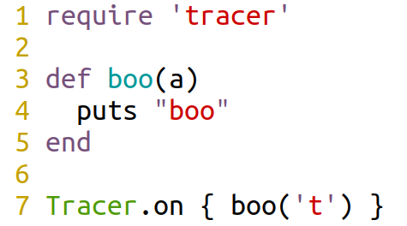
Tracer
ruby -rtracer trace_simple.rb
#0:.../kernel_require.rb:54:Kernel:<: return gem_original_require(path)
#0:trace_simple.rb:1::-: def boo(a)
#0:trace_simple.rb:4::-: boo('t')
#0:trace_simple.rb:1:Object:>: def boo(a)
#0:trace_simple.rb:2:Object:-: puts "boo"
boo
#0:trace_simple.rb:3:Object:<: end
ruby trace_add_tracer.rb
#0:trace_add_tracer.rb:7::-: Tracer.on { boo('t') }
#0:trace_add_tracer.rb:3:Object:>: def boo(a)
#0:trace_add_tracer.rb:4:Object:-: puts "boo"
boo
#0:trace_add_tracer.rb:5:Object:<: end
Notes:
is too verbose

Slide 6
debug[ger] (+byebug)
ruby debug_add_debug.rb
debug_add_debug.rb:3: puts "boo"
(rdb:1) p a
"t"
(rdb:1) l
[-2, 7] in debug_add_debug.rb
1 def boo(a)
2 require 'debug'
=> 3 puts "boo"
4 end
5
6 boo('t')
(rdb:1) c
boo
ruby -rdebug debug_simple.rb
debug_simple.rb:1:def boo(a)
(rdb:1) l
[-4, 5] in debug_simple.rb
=> 1 def boo(a)
2 puts "boo"
3 end
4
5 boo('t')
(rdb:1) break 2
Set breakpoint 1 at debug_simple.rb:2
(rdb:1) c
Breakpoint 1, boo at debug_simple.rb:2
debug_simple.rb:2: puts "boo"
(rdb:1) p a
"t"

Slide 7
Byebug
--no-stop
.byebugrc [~/, $PWD/]

Slide 8
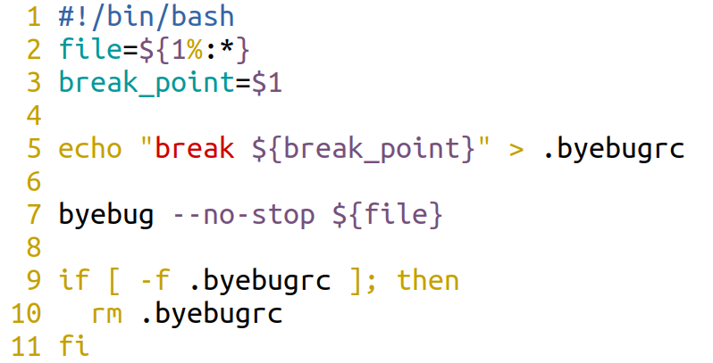
my_bug.bash & custom VIM command

Slide 9


Thanks
@otaznik_net
https://github.com/otaznik-net/debug_rb

